Slide 1


< Empowering Your Digital Future! />

Slide 2


ABOUT DEVOTORY SOLUTIONS
At Devotory Solutions, we are dedicated to enhancing your business through top-tier resource augmentation for AI, web, and mobile app development. Our team of skilled professionals delivers innovative solutions that turn your ideas into reality, ensuring you remain competitive and ahead of the curve.
GLOBAL TALENT
AFFORDABLE EXCELLENCE
We connect you with the most talented software developers from around the world.
Benefit from exceptional skills at competitive rates.
INNOVATIVE SOLUTIONS
From cutting-edge AI applications to robust web and mobile solutions, we bring creativity and technical expertise to every project.

Slide 3
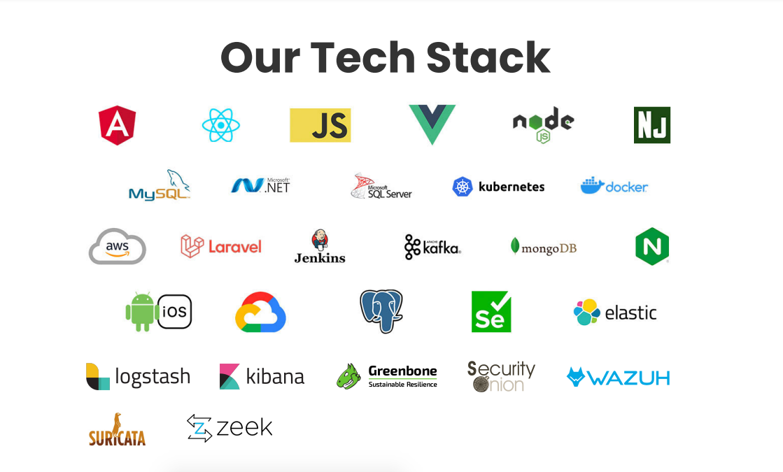

Slide 4



OUR SERVICE
Web Development
Dedicated Development Team
AI & App Development
At Devotory Solutions, we provide end-to-end web development services across all major frameworks and technologies, ensuring a tailored approach to meet your unique needs.
  Backend Development: Build powerful, scalable server-side solutions using technologies like .NET and Python, designed to handle complex business logic and integrate seamlessly with various systems.
  Frontend Development: Create engaging, user-friendly interfaces with modern frameworks including Angular, React, and Next.js. Our focus is on delivering intuitive and responsive designs that enhance user experience.
  Custom Solutions: Whether you need a robust e-commerce platform, a dynamic content management system, or a custom-built web application, we tailor our services to meet your specific requirements.
We provide dedicated development teams at competitive hourly rates, giving you access to top-tier talent without the overhead of traditional hiring. Our developers are highly skilled and bring a wealth of experience to your projects. Here’s what we offer:
  Top Talent: Our developers are carefully selected for their expertise and ability to deliver high-quality results.
  Affordable Rates: Enjoy exceptional skills at a cost-effective price point.
  Flexible Engagement: Start with a one-month free trial to assess our developers' performance and fit for your project.
  Seamless Integration: Our teams work as an extension of your in-house staff, ensuring smooth collaboration and project alignment.
At Devotory Solutions, we excel in developing cutting-edge AI applications that drive innovation and deliver impactful results. Our expertise spans a range of AI technologies and methodologies, tailored to meet your specific needs:
  Machine Learning (ML): Build intelligent systems that learn and adapt from data to provide predictive insights and automate processes.
  Artificial Intelligence (AI): Develop advanced AI solutions to enhance decision-making, improve efficiency, and create smarter applications.
  Large Language Models (LLM): Implement sophisticated language models for natural language understanding and generation, enabling advanced conversational interfaces and more.

Slide 5




OUR CLIENTS
ASA: Artificial Sales Agent is a fair marketplace for small businesses who produce unique products with revenues between 25k – 10M
Edible Arrangements, LLC is a U.S.-based franchising business that specializes in fresh fruit arrangements, combining the concept of a fruit basket with designs inspired by flower arrangement.
CareCloud, Inc. is a leading healthcare technology company with a comprehensive suite of proprietary, cloud-based solutions for growing healthcare organizations.
A global IP investment and tech transfer company based in Oxford, England. We connect with 4,500 universities across 160 countries to help clients unlock value from new discoveries.

Slide 6


MEET THE FOUNDERS
Attiq Ur Rehman
Habib Ur Rehman
Founder, CEO
Co-Founder, CTO
With over a decade of experience in software development, entrepreneurship, and managing large-scale projects, Attiq has led Devotory Solutions to deliver top-notch IT services. His expertise extends to working with Fortune 500 companies, driving innovation, and ensuring success in every venture we undertake.
As the Co-Founder and CTO of Devotory Solutions, Habib brings over a decade of experience in software development, project management, and fintech. His expertise and leadership are instrumental in driving our mission to deliver innovative IT solutions, ensuring our clients stay ahead in the digital landscape.

Slide 7

CASE STUDIES

Slide 8
Powering TekCapital's Invention Evaluator
Client Overview:
Client Name: TekCapital
Location: United States
Project: Invention Evaluator
Domain: Data Analytics
Client Challenge:
TekCapital required a dedicated team of senior .NET and Angular developers, a DB admin, and a deployment team with Azure expertise to enhance their Invention Evaluator project in the data analytics domain. Timely delivery of their quarterly goals was critical.
Our Solution:
Devotory Solutions quickly addressed TekCapital's requirements by sourcing top-tier candidates, conducting thorough technical interviews, and onboarding a specialized team within a month. This team, expertly tailored to the needs of TekCapital's Invention Evaluator project, played a key role in enhancing project performance and ensuring timely delivery of their quarterly objectives.

Slide 9
Powering TekCapital's Invention Evaluator
Impact:
The team provided by Devotory Solutions had a transformative impact on the performance of TekCapital’s Invention Evaluator project. Our experts quickly integrated into the project, bringing a wealth of experience and technical proficiency that significantly enhanced the system's efficiency and accuracy. As a result, TekCapital consistently met their quarterly objectives, delivering high-quality data analytics solutions on time.
This case study underscores Devotory Solutions' capability to rapidly deploy specialized teams that not only meet but exceed client expectations, ensuring that project milestones are achieved with excellence and reliability.

Slide 10

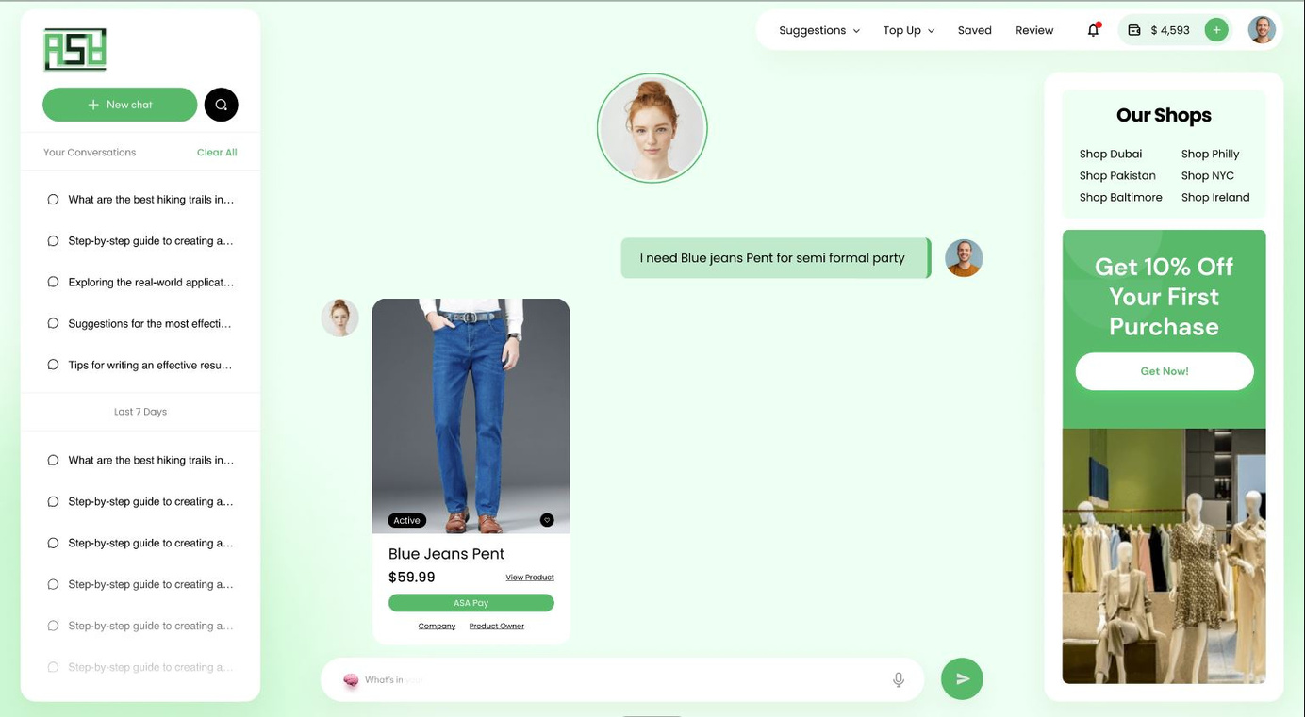

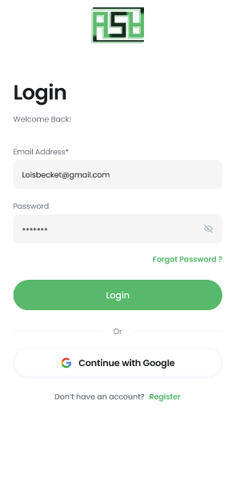
ARTIFICIAL SALES AGENT- ASA

Slide 11
ARTIFICIAL SALES AGENT- ASA
Client Overview:
Client Name: ASA (Artificial Sales Agent)
Location: United States
Industry: E-Commerce & Artificial Intelligence
Client Challenge:
ASA a pioneering company in the e-commerce space, approached Devotory Solutions
with an ambitious vision. They wanted to create an AI-powered marketplace where end-users could effortlessly chat with a system to find and purchase products from various online stores. The goal was to simplify the shopping experience by integrating multiple sources into a single, seamless chat interface.
Our Analysis:
Upon reviewing ASA's requirements, our team at Devotory Solutions recognized that
this challenge was a perfect fit for a Large Language Model (LLM)-based solution. The complexity of understanding user intent, managing a dynamic conversation, and providing accurate product recommendations across different e-commerce platforms required the intelligence and adaptability of an LLM.

Slide 12
Our Solution
To meet ASA's needs, we implemented the following:
LLM-Powered Assistant:
We developed a custom LLM system to understand user queries, engage in dynamic conversations, and provide relevant product suggestions from
multiple e-commerce platforms. This system was optimized to handle everything from product discovery to final purchase, ensuring an intuitive and
efficient user experience.
Data Processing and Cleaning:
ASA’s large dataset was meticulously processed using advanced data science techniques, including data normalization, outlier detection, and missing data imputation. We also applied feature engineering and dimensionality reduction to ensure the LLM delivered precise, accurate results based on user queries.
Modern Chat-Based E-Commerce Application:
We designed a cutting-edge chat-based application using Angular 13. This responsive interface allows users to interact seamlessly with the AI assistant, providing a smooth, user-friendly experience for finding and purchasing products across multiple platforms.
Results:
Enhanced Engagement: The AI-powered chat interface made user interaction easier and more enjoyable.
Higher Conversion Rates: The streamlined shopping experience led to increased conversions.
Accurate Recommendations: Rigorous data processing ensured precise, relevant product suggestions.
Scalability: The solution allows ASA to integrate additional platforms effortlessly as they grow.

Slide 13








OUR CONTACT
+92-3345888159
+1 209 500 1603
www.devotory.com
info@devotory.com
Islamabad, Pakistan
Philadelphia, USA

